Slide 1


Innovative Landfill Exploration and Mechanical Processing
The NEW-MINE project has received funding from the European Union's EU Framework Programme for Research and Innovation Horizon 2020 under
Grant Agreement No. 721185; www.new-mine.eu
J.C. Hernández Parrodi, C. Bobe, C. García López and B. Küppers
Renewi Belgium, UGent, RWTH Aachen and Montanuniversität Leoben
5th International Symposium on Enhanced Landfill Mining Symposium (ELFM V)
February 6th 2020, Leuven - Belgium

Slide 2
Overview
Context
Geophysical exploration of landfill site
Excavation of landfill waste
Mech. (pre-)processing of excavated waste
Sensor-based sorting
Conclusions
5th International Symposium on Enhanced Landfill Mining (ELFM V), February 6th 2020, Leuven - Belgium

Slide 3
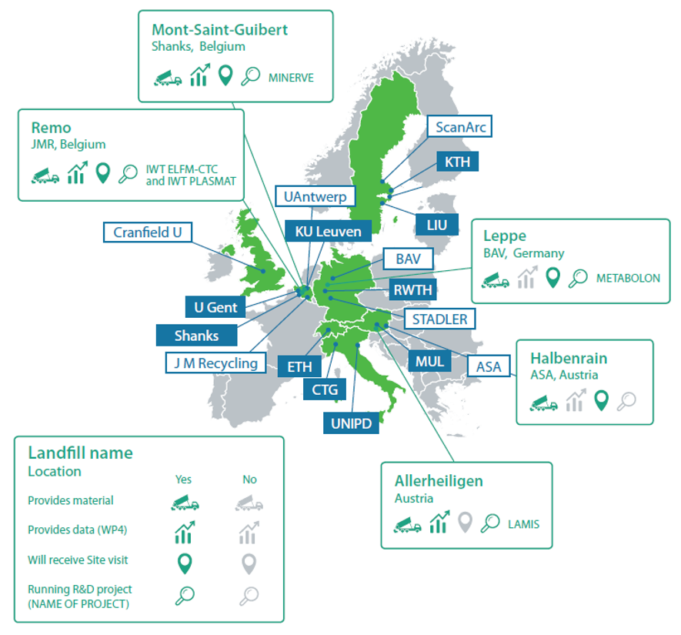
Context
EU research program
Consortium of 17 partners
Universities, research institutions and industry
Test and study implementation of ELFM
  Legacy landfills & dumpsites
  Environmental & health impacts
  Land reclamation
  Waste-to-material (WtM)
  Waste-to-energy (WtE)
5th International Symposium on Enhanced Landfill Mining (ELFM V), February 6th 2020, Leuven - Belgium

Slide 4
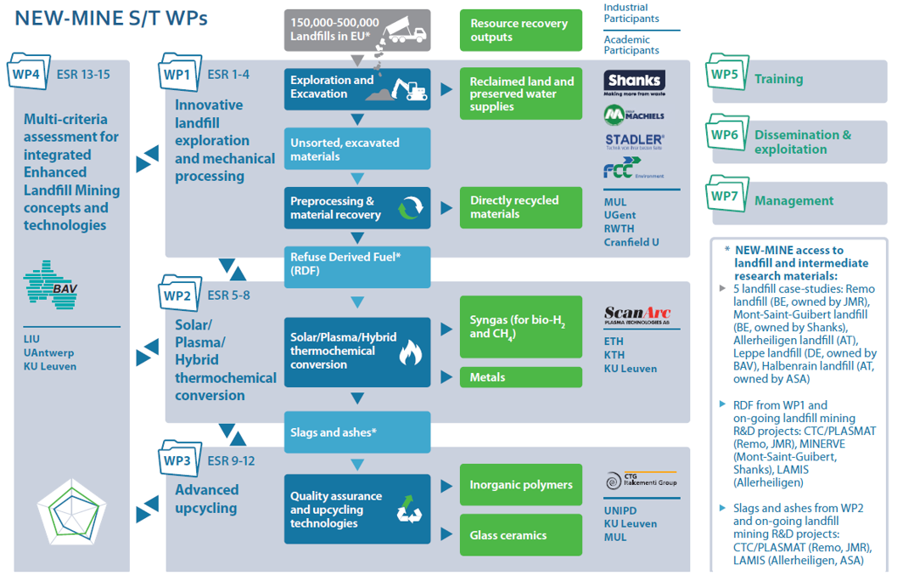
Context
5th International Symposium on Enhanced Landfill Mining (ELFM V), February 6th 2020, Leuven - Belgium

Slide 5
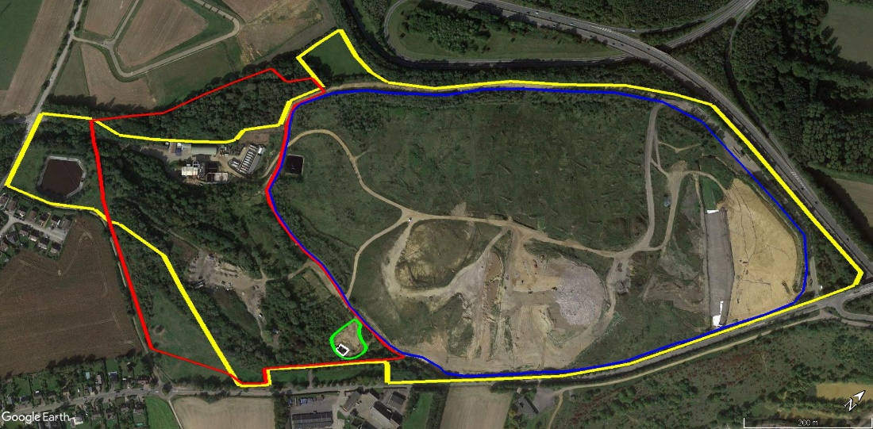
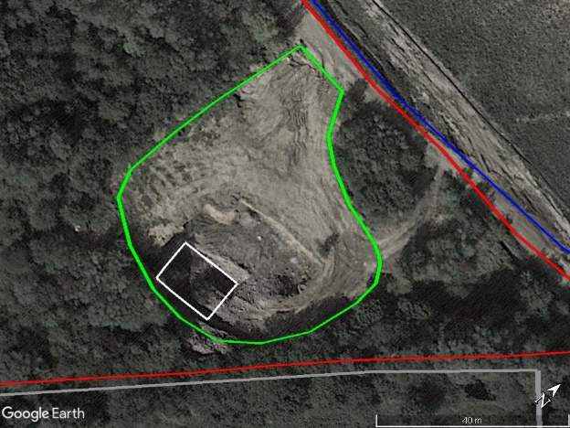
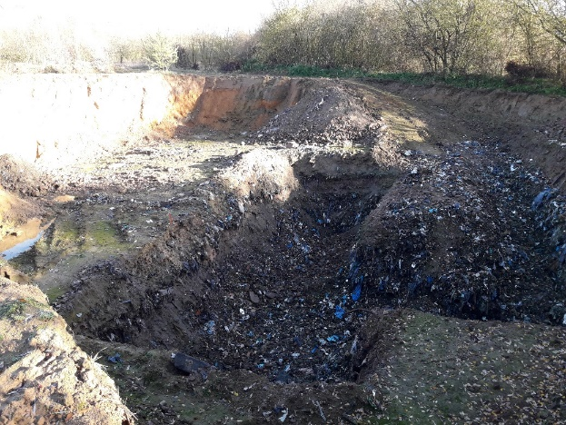
Context
NEW-MINE´s case study on implementation of ELFM
MSG landfill
Landfill site in Mont-Saint-Guibert (MSG), Belgium
Old part of landfill
  1958 - 2014
MSW, C&D and non-hazardous IW
Excavation zone
Excavated volume
Geophysical exploration & material excavation in Jul.-Sep. 2017
5th International Symposium on Enhanced Landfill Mining (ELFM V), February 6th 2020, Leuven - Belgium

Slide 6
Geophysical exploration
Exploration of contrasts in electrical properties of waste material
Electrical property = Resistance/Conductance
Contrast in conductance = contrast in material?
1. Estimation of waste volume: Capping thickness estimation
5th International Symposium on Enhanced Landfill Mining (ELFM V), February 6th 2020, Leuven - Belgium

Slide 7
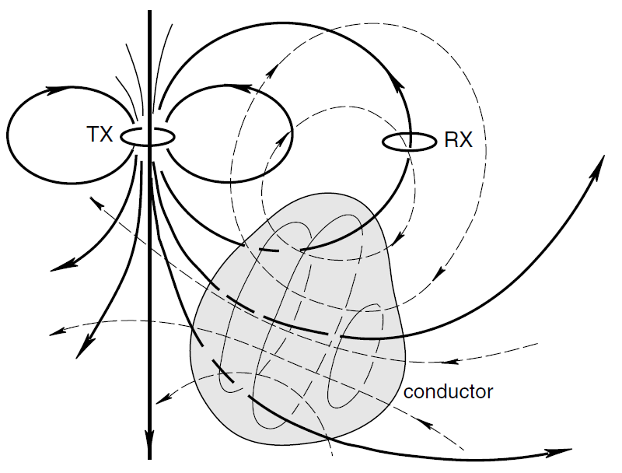
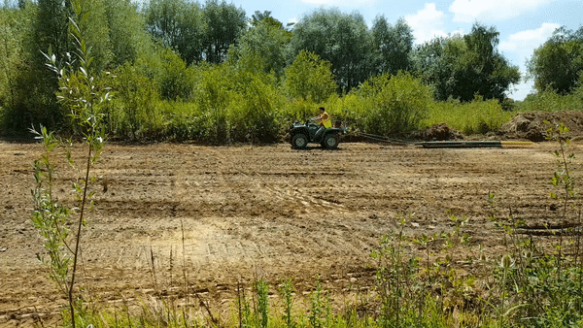
Induction survey
5th International Symposium on Enhanced Landfill Mining (ELFM V), February 6th 2020, Leuven - Belgium

Slide 8
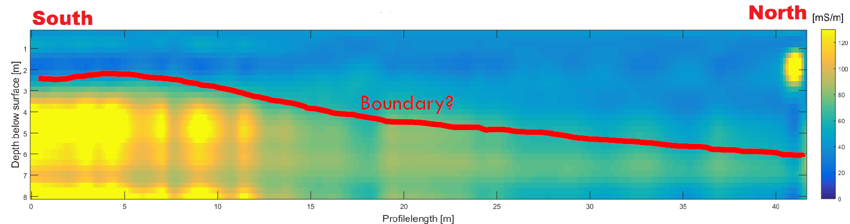
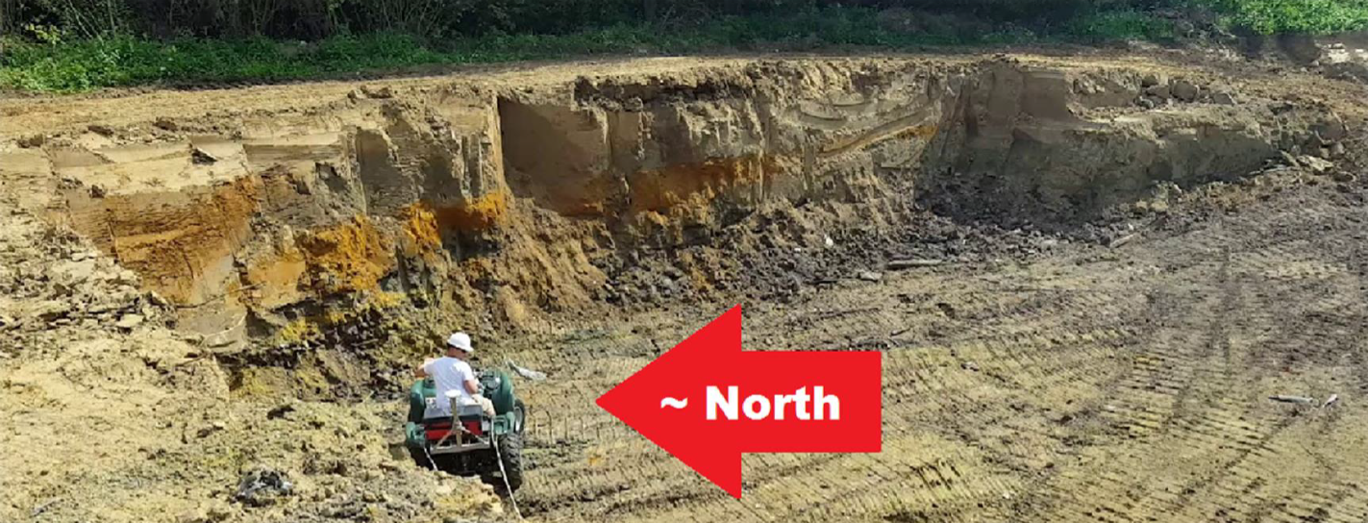
Results - Induction survey
Conductivity
North

Slide 9
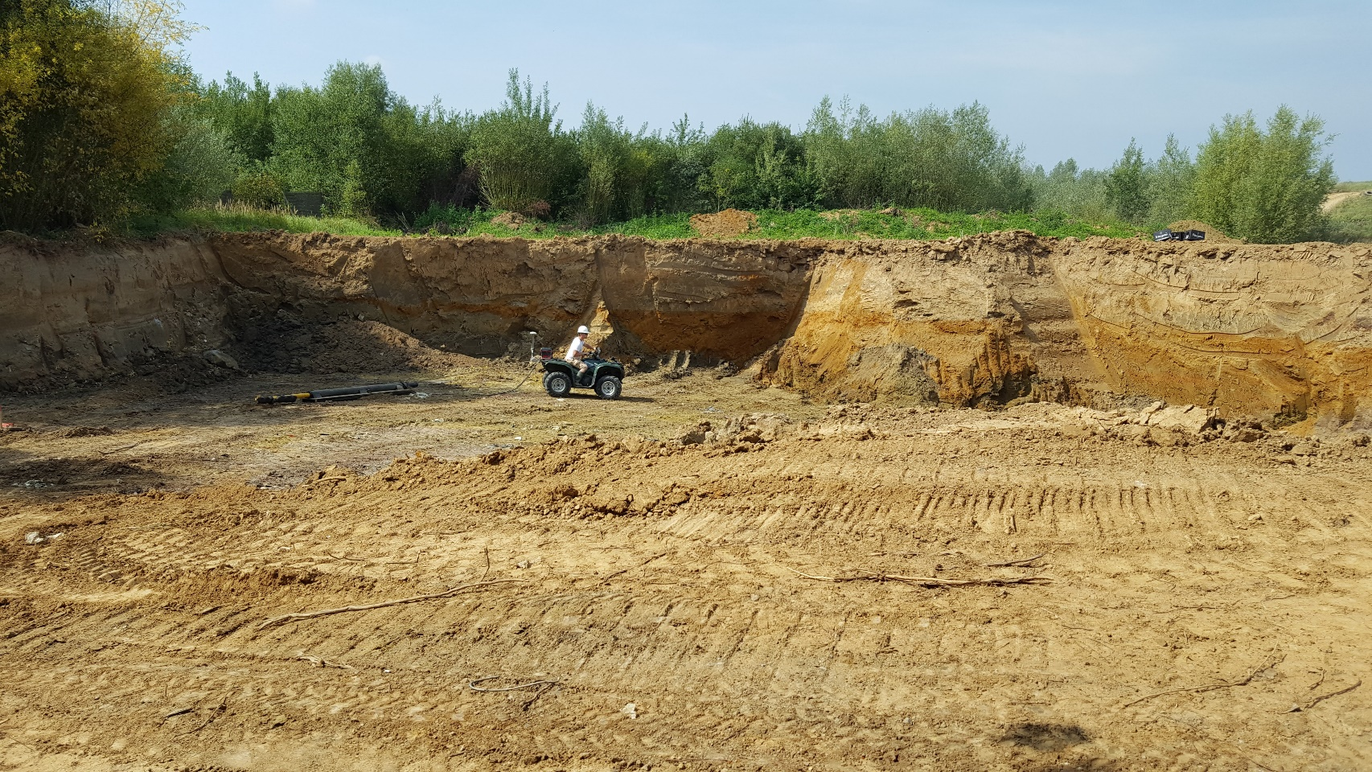
Second survey – Waste material
2. Exploration of the electrical conductivity of the waste

Slide 10
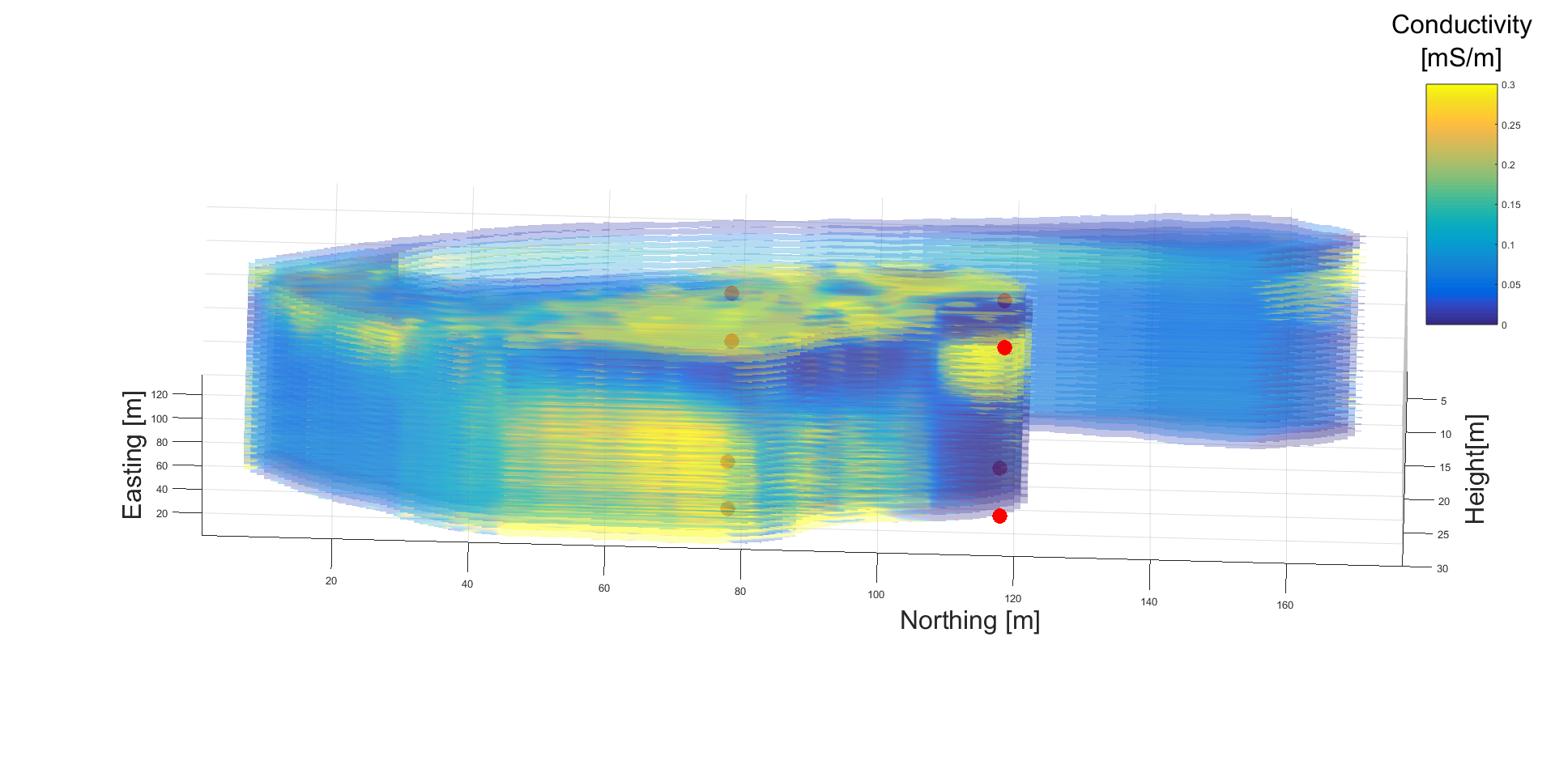
Second survey – Waste material
2. Exploration of the electrical conductivity of the waste

Slide 11
Second survey – Waste material
2. Exploration of the electrical conductivity of the waste
Large variation in electrical conductivity
= large variation in waste material composition?

Slide 12
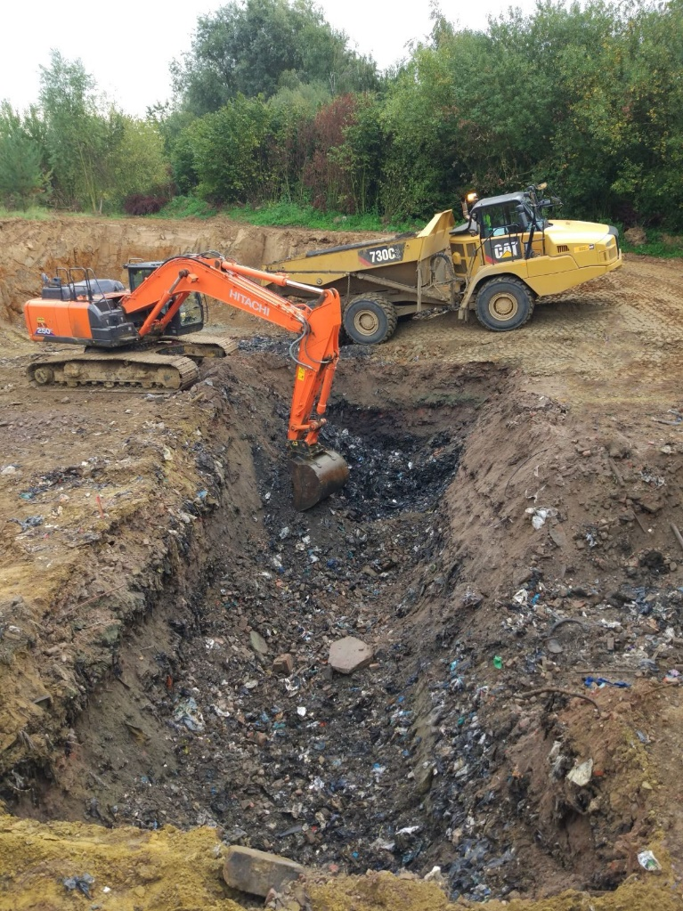
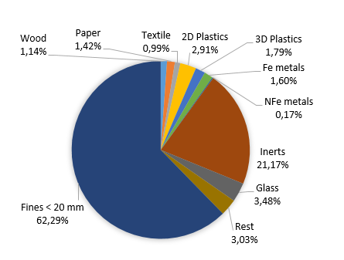
Excavation of LF waste
Waste excavation
Total of ~370 Mg of waste excavated
Avg. bulk density of ~800 kg/m³
Avg. water content of ~30 wt.% (raw state)
Avg. material composition:
5th International Symposium on Enhanced Landfill Mining (ELFM V), February 6th 2020, Leuven - Belgium

Slide 13
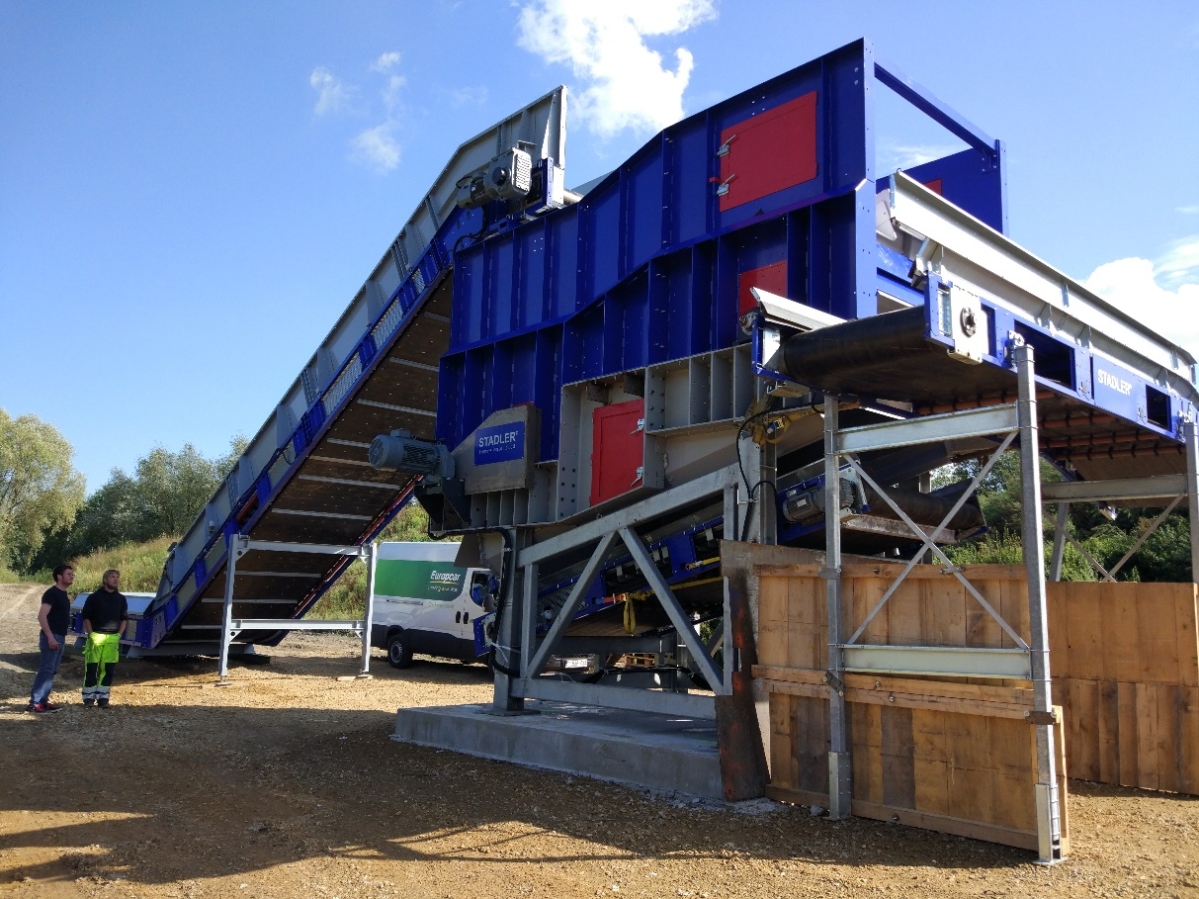
Mech. pre-processing
Ballistic separation
Ballistic separator Stadler STT 600
  3D fraction
  2D fraction
  Under-screen fraction
Landfill waste processed directly after exc.
Avg. throughput ~200 m³/h
5th International Symposium on Enhanced Landfill Mining (ELFM V), February 6th 2020, Leuven - Belgium

Slide 14
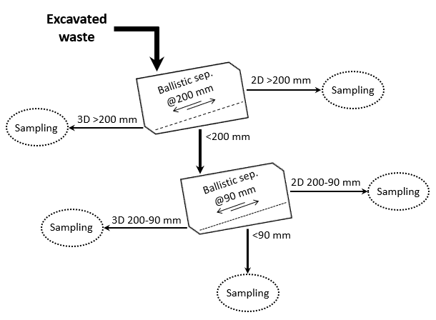
Mech. pre-processing
3 wt.%
4 wt.%
5 wt.%
11 wt.%
77 wt.%
(wt.% in raw state)
5th International Symposium on Enhanced Landfill Mining (ELFM V), February 6th 2020, Leuven - Belgium

Slide 15
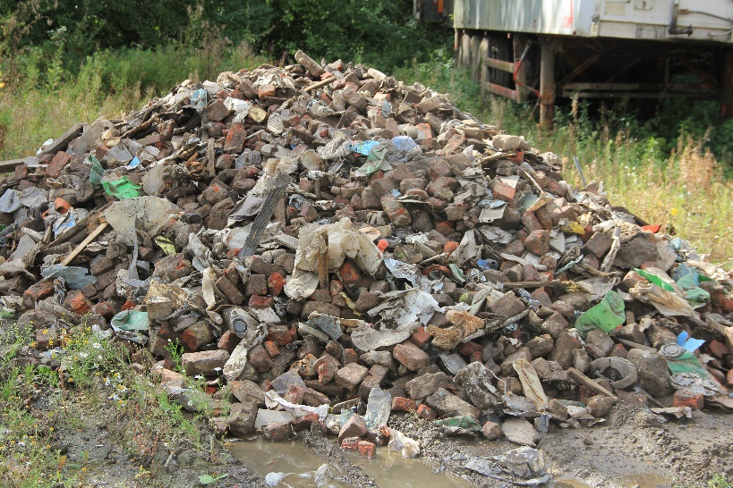
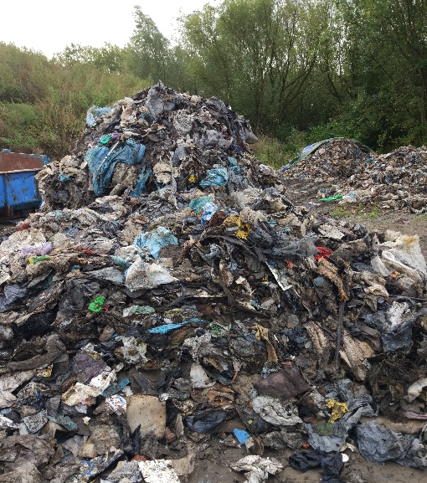
Mech. processing of coarse fractions
 | 3D Fraction |  | 2D Fraction
 | 3D > 200 mm | 3D 200-90 mm | 2D > 200 mm | 2D 200-90 mm
RDF | 11,3% | 8,7% | 56,5% | 64,7%
Metals | 5,7% | 5,6% | 1,6% | 2,7%
Inert | 83,1% | 77,5% | 7,1% | 1,3%
Fines <20 mm | *0,0% | 8,2% | 34,8% | 31,2%
  → WtE
  → WtM
5th International Symposium on Enhanced Landfill Mining (ELFM V), February 6th 2020, Leuven - Belgium

Slide 16
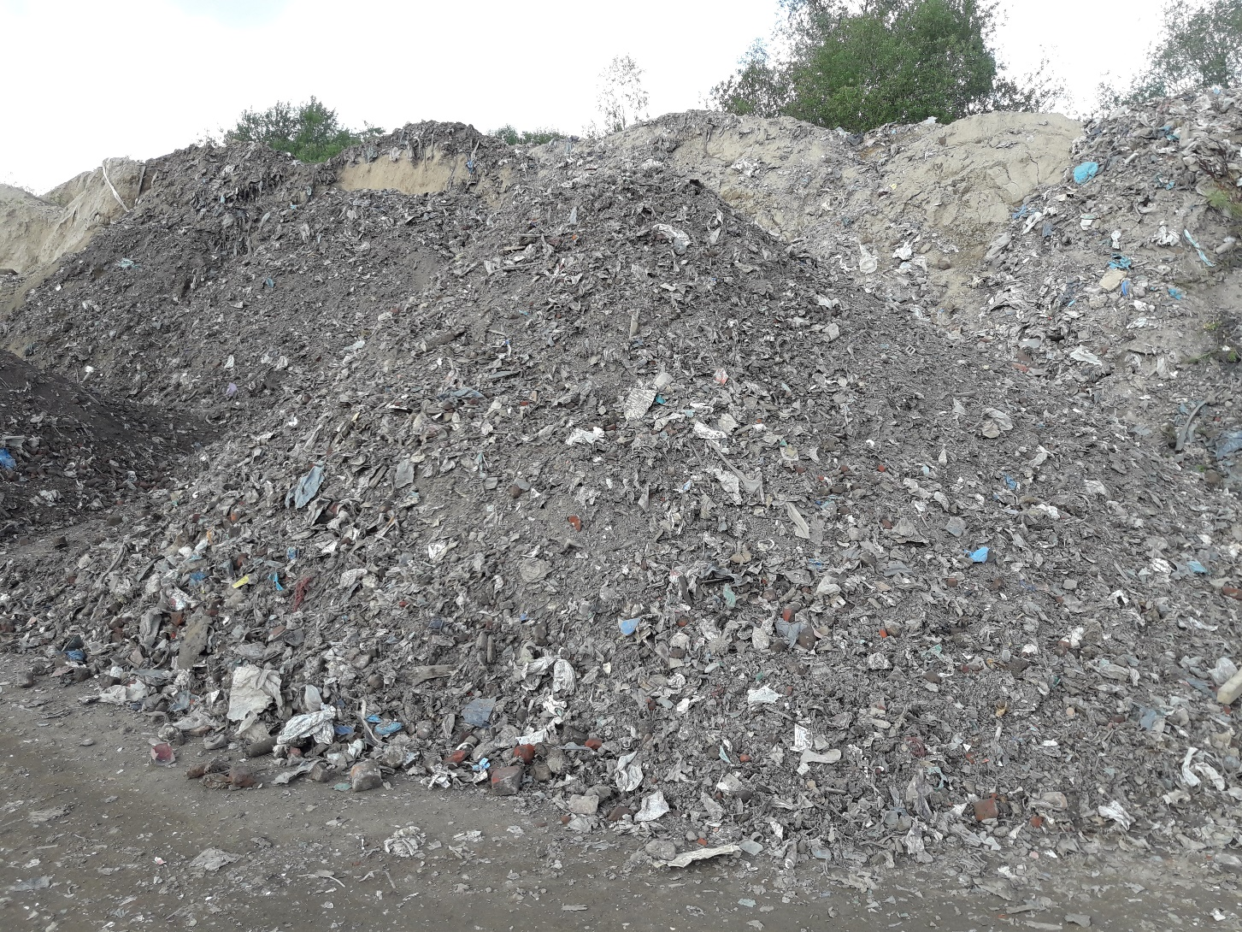
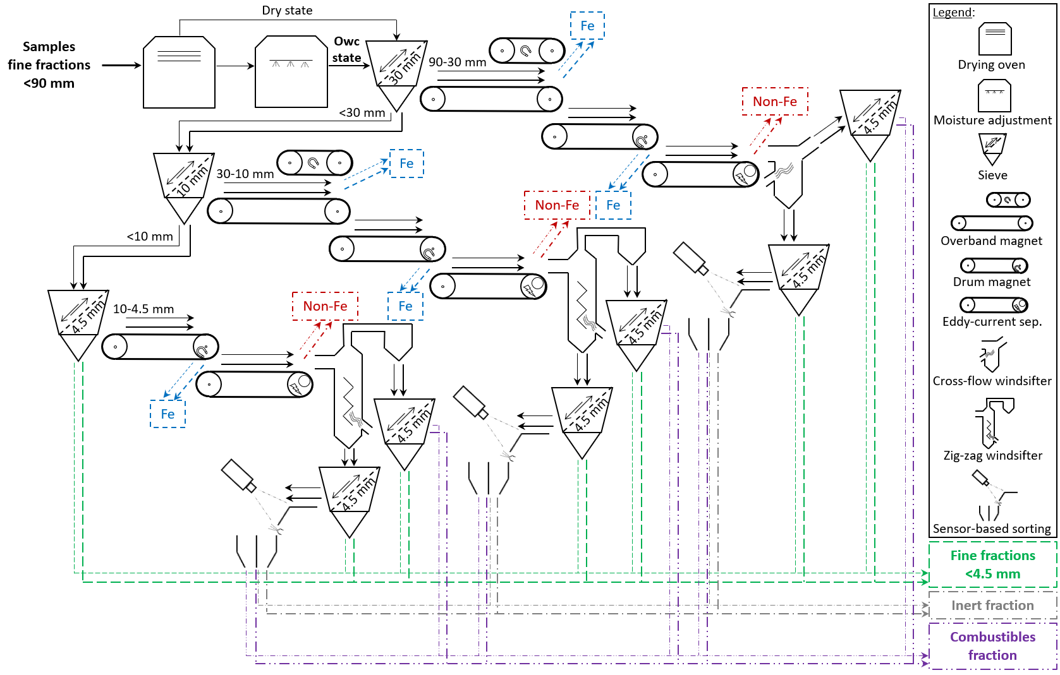
Mech. processing of fine fractions 90-4.5 mm
WC adjustment
90-30 mm & 30-10 mm
Fine fractions <4,5 mm
Inert fraction
Combustibles fraction
Fe metals
10-4,5 mm
Non-Fe metals
5th International Symposium on Enhanced Landfill Mining (ELFM V), February 6th 2020, Leuven - Belgium

Slide 17
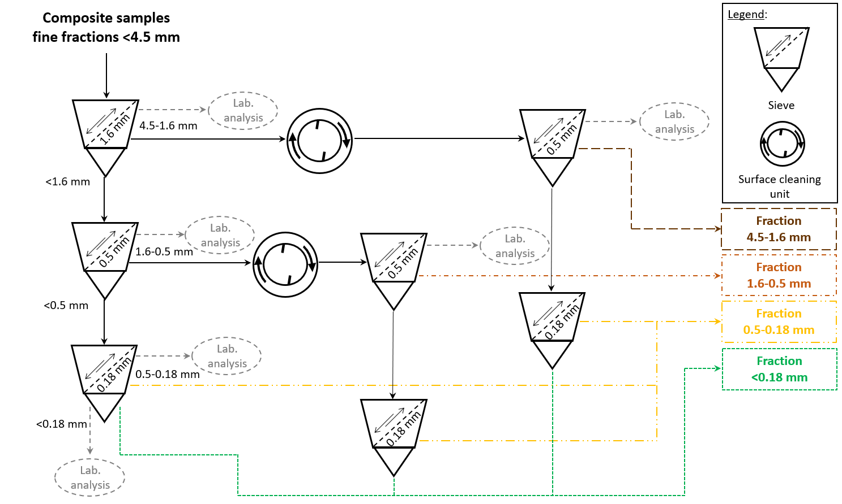
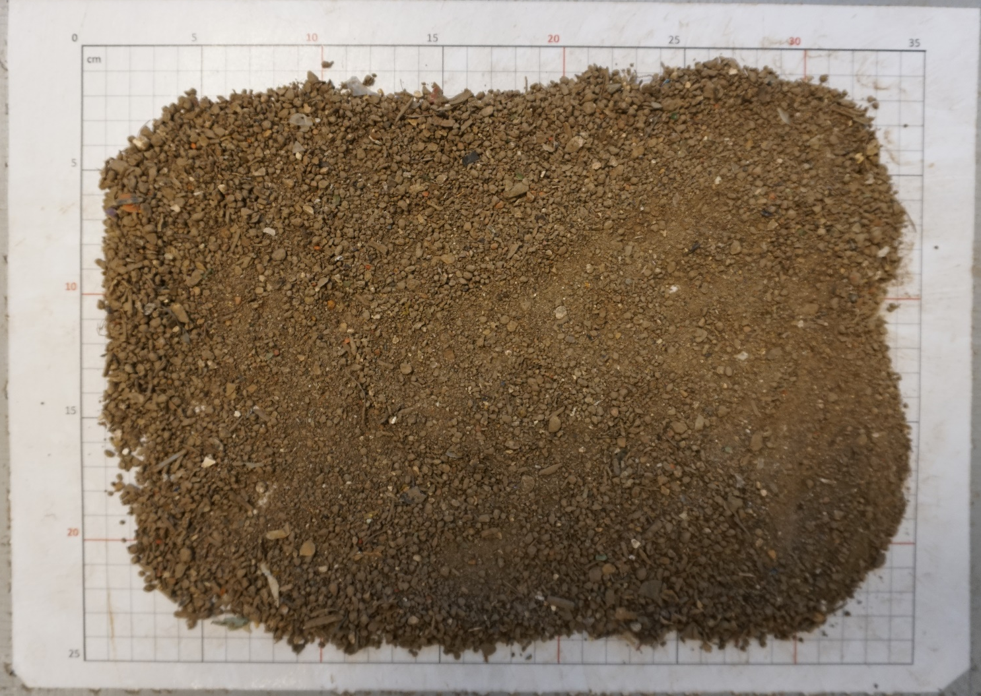
Mech. processing of fine fractions <4.5 mm
5th International Symposium on Enhanced Landfill Mining (ELFM V), February 6th 2020, Leuven - Belgium

Slide 18
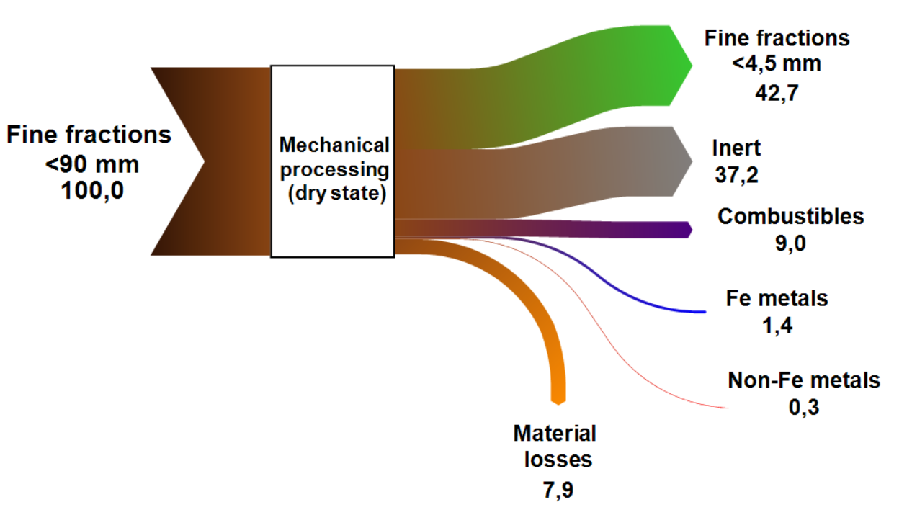

Mass balance of mech. processing of fine fractions
→ Substitute for soil in construction applications
TOC, Cd, Cu, Hg, Pb, Zn and Ni !
  → Substitute for construction aggregates
Pb, ammonium-N and hydrocarbon contents !
  → RDF
As, Cd, Co, Hg and Pb !
  → Recycling
5th International Symposium on Enhanced Landfill Mining (ELFM V), February 6th 2020, Leuven - Belgium

Slide 19
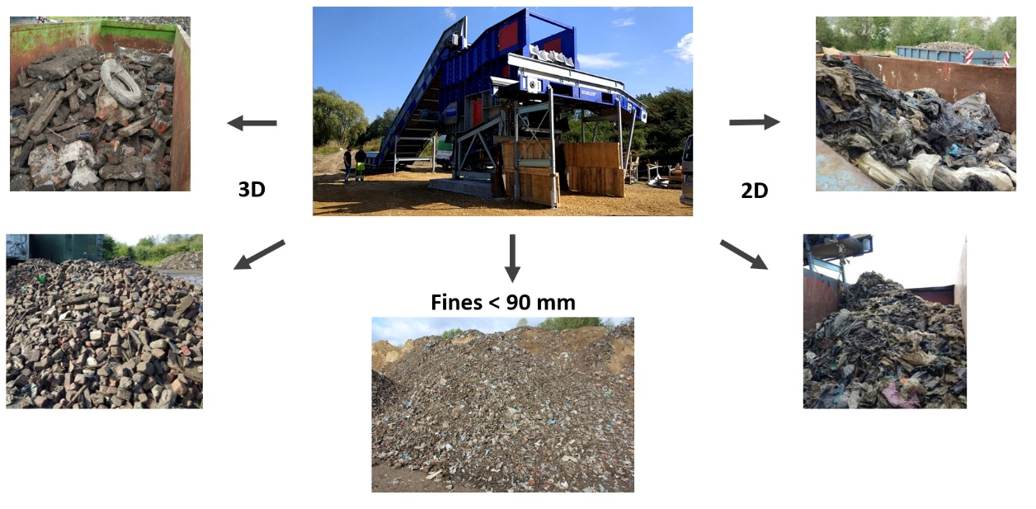
Sensor-based sorting
Input to SBS:
3D fractions from ballistic sep.:
  200-90 mm
Heavy fractions from density sep. of fine fractions:
  90-30 mm
  30-10 mm
  10-4.5 mm
Influences on ejection:
Input composition influences product yield & purity
Throughput rate = Factor for sorting performance
Influences on NIR-detection:
Surface defilements
Humidity alters IR-spectra
Surface roughness
→ Impede detection
→ Hinders detection
→ Improves identification
5th International Symposium on Enhanced Landfill Mining (ELFM V), February 6th 2020, Leuven - Belgium

Slide 20
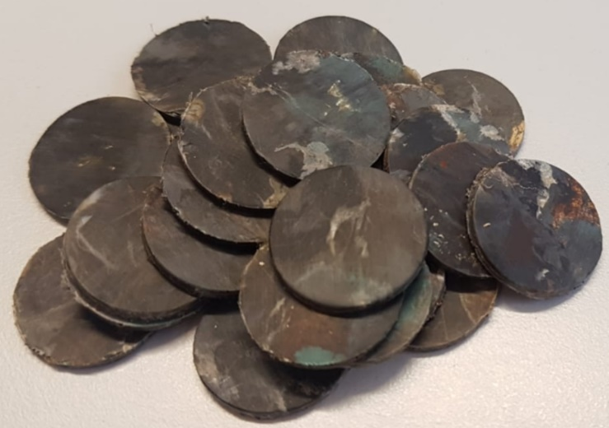
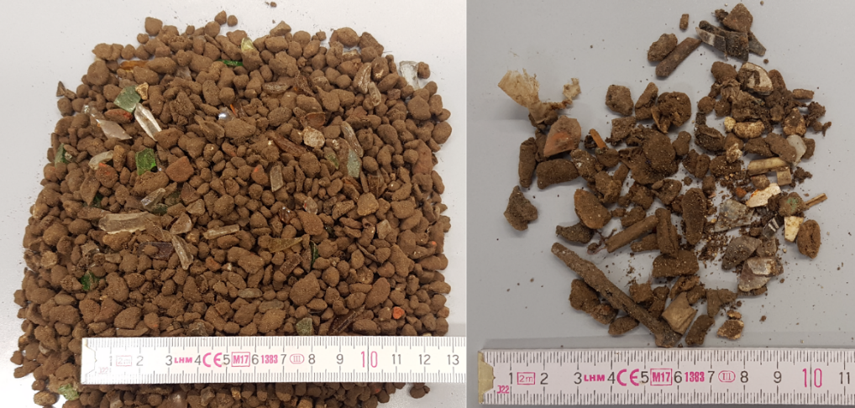
Sensor-based sorting
Refuse plastic chips
Potential of SBS in ELFM:
Separation of plastic types (>40 mm)
Sep. of combustible and inert materials
Inert
Combustible
Challenges of SBS in ELFM:
Surface defilements in fine fractions
Legislation inhibiting use of recycling products from ELFM
Economic feasibility
5th International Symposium on Enhanced Landfill Mining (ELFM V), February 6th 2020, Leuven - Belgium

Slide 21
Conclusions
Geophysical methods can optimize site exploration
  Correlation between geophysical measurements and waste characteristics still challenging
Potential of landfill-mined waste:
  Waste-to-Material
    Ferrous & non-ferrous metals → Recycled metals
    3D fractions (≥90 mm) and inert material (<90 mm)
    → Construction aggregates
    Soil-like fractions (<90 mm) → Soil substitute in construction applications
  Waste-to-Energy
    2D fractions (≥90 mm) and combustible material (<90 mm) → Alternative fuel (RDF)
5th International Symposium on Enhanced Landfill Mining (ELFM V), February 6th 2020, Leuven - Belgium

Slide 22
Conclusions
Sensor-based sorting can enhance outputs for WtM and WtE schemes
  Can significantly affect economic feasibility
In the EU WtM and WtE valorization schemes strongly depend on national and local regulations
Greatest challenge in (E)LFM frequently lays on economic feasibility rather than on technical aspects
5th International Symposium on Enhanced Landfill Mining (ELFM V), February 6th 2020, Leuven - Belgium

Slide 23


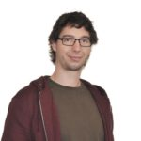
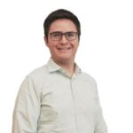
5th International Symposium on Enhanced Landfill Mining
| February 6th 2020 | Leuven - Belgium
Cristina García López
RWTH Aachen
Cristina.GarciaLopez@IAR.RWTH-Aachen.de
THANK YOU FOR YOUR ATTENTION!
Christin Bobe
UGent
Christin.Bobe@UGent.be
Bastian Küppers
Montanuniversität Leoben
Bastian.Kueppers@UniLeoben.ac.at
Juan Carlos Hernández Parrodi
Renewi Belgium SA/NV
Juan.Carlos.Parrodi@Renewi.com
The NEW-MINE project has received funding from the European Union's EU Framework Programme for Research and Innovation Horizon 2020 under Grant Agreement No. 721185;
www.new-mine.eu

